Slide 1

Other Searches
Additional Approaches

Slide 2

Composite Heuristics
Sometimes a heuristic is made up of several other heuristics. We call this a composite heuristic.
Composite Heuristics…
Can be used in any heuristic search (Greedy, A*,…)
Include any combination of component heuristics
Can be admissible under the right circumstances
Common Compositing Functions
Minimum (min(h₁, h₂ , h₃ , … h_{n}))
Maximum (max(h₁, h₂ , h₃ , … h_{n}))
Straight Sum (h₁ + h₂ + h₃ + … h_{n})
Weighted Sum (h₁* w₁ + h₂* w₂ + … h_{n}* w_{n})
Composite Heuristics often work best when empirical data can be gathered through experimentation.

Slide 3


Trial and Error Search
At other times, CPU time is limited and search must be performed incrementally.
We can use Trial and Error Search for such purposes.
During trial and error search, steps are decided and executed sequentially.
When an obstacle is encountered, an avoidance technique is employed.
Trial and Error Search is:
Not systematic
Informed*
Not optimal
Not complete
Not exhaustive
Benefits of Trial and Error:
Can be performed in real time (incrementally)
Low memory usage
Low CPU time usage
Problems with Trial and Error:
No memory whatsoever – can loop forever
Neither optimal nor complete
Random - unpredictable
Trial and Error techniques are simple and useful for maps with few obstacles.

Slide 4
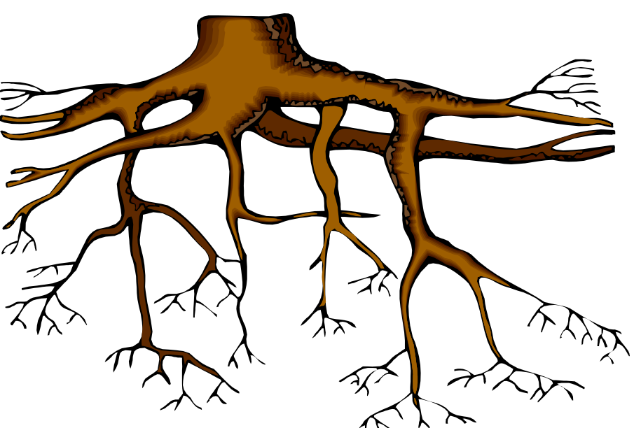
Depth-First Search
Sometimes Breadth-First Search derivatives are too memory intensive.
We can use a Depth-First Search (DFS) to limit the memory used.
Depth-First Search is:
Systematic
Uninformed
Not optimal
Not complete
Exhaustive
Benefits of Depth-First Search:
Low memory usage.
It’s easy to write.
That’s basically it.
Problems with Depth-First Search:
Has no memory of past events (proper dupe checking is not possible)
Takes a long time to execute
Is neither optimal nor complete
For these reasons, DFS is ill-suited for most well-defined problems.

Slide 5
Iteratively Deepening Depth-First Search
We can progressively build the depth-first search, one ply each pass, until we find a solution.
This will limit the memory used and is called Iteratively Deepening Depth-First Search (IDDFS.)
Iteratively Deepening Depth-First Search is:
Systematic
Uninformed
Optimal in steps
Complete
Exhaustive
Benefits of IDDFS:
Low memory usage
Optimal & complete
Problems with IDDFS:
Repeats building of tree with each pass
Takes a looong time to execute
IDDFS is useful for some specialized, low memory purposes.

